Slide 1

Primerica Legal Protection Program Offered by LegalShield
FUNDAMENTALS

Slide 2
Primerica Legal Protection Program

Slide 3
Available PLPP Plans
Primerica offers three plans through the Primerica Legal Protection Program:
Plan | Family Plan | Group Plan | Business Plan
Cost | $28 month (Full Benefit States) $26 month (NV) $20 month (Limited benefit States NY) | $26.95 (Full benefit states) $24.95 month (NV) $20 month (Limited benefit States NY) | $75 per month for 1 to 50 employees $125 per month for 51 to 99 employees $69 per month for 1 to 50 employees $115 per month for 51 to 99 employees (Limited Benefit State NY) * Check business plan availability on POL
Enrollment Fee | $10 one-time enrollment fee | No enrollment Fee | $10 one-time enrollment fee
Offered | Offered in a one-on-one setting at the KT | Offered to a group | Offered to a Business Owner with fewer than 100 employees, no publicly traded stock, for profit business
Coverage | Member, Spouse and all eligible dependents | Member, Spouse and all eligible dependents | Business Owner

Slide 4
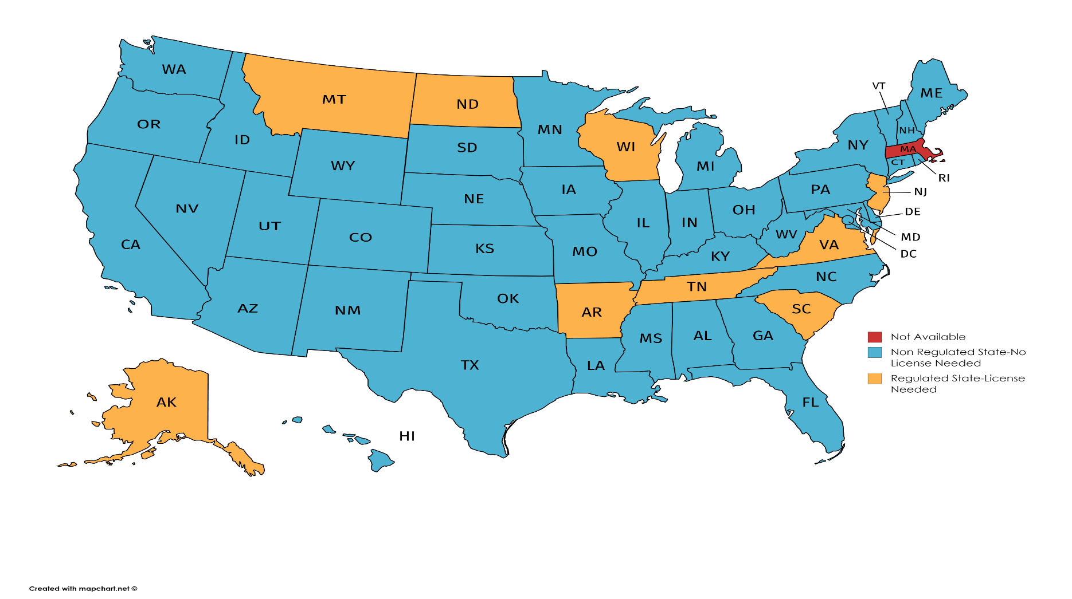
PLPP Licensing Requirements
See POL for detailed information regarding licensing requirements in your state

Slide 5

Family & Group Plan Coverage
The member
The member’s spouse
Never-married, dependent children who are under 26 and living at home
Dependent children under the age of 18 for whom the member is legal guardian
Never-married, dependent, children who are full-time college students up to age 26
Physically or mentally disabled children living at home
Must be unable to be employed and 51% or more financially dependent on Member or Member’s spouse and live at home

Slide 6
PLPP Family and Group Plan
Legal Consultation
Letters/Calls made on the member’s behalf
Personal Legal Document Review of 15 Pages
24/7 Emergency Access
Residential Loan Document Services
Family and Domestic Related Services
Uncontested Separation or Annulment
Uncontested Divorce
Uncontested Name Change
Uncontested Adoption
Estate Planning Services
Last Will & Testament (Will)
Durable Power of Attorney
Physician’s Directive/Living Will
Probate Services
Motor Vehicle Services
IRS Audit Assistance
Trial Defense
Pre-Trial
Trial
IRS Audit Legal Services
Contingency Fee Matters
25% Preferred Member Discounts

Slide 7
Family Plan Commissions
 | Full Benefit States $28 per month $26 per month in NV |  | Limited Benefit State (NY) $20.00 per month
Level | 2-Year Advance | Year 3+ | 2-Year Advance | Year 3+
REP | 50.00 |  | 40.00
SR REP | 60.00 |  | 48.00
DIS | 80.00 |  | 64.00
DIV | 90.00 |  | 72.00
REG | 100.00 |  | 80.00
RVP | 125.00 | 9.96 | 100.00 | 7.92
1 GEN | 10.00 | 27.00 | 8.00 | 22.00
2 GEN | 7.00 | 13.00 | 5.00 | 11.00
3 GEN | 4.00 | 12.00 | 3.00 | 9.00
4 GEN | 2.00 | 7.00 | 2.00 | 6.00
5 & 6 GEN | 1.00 | 3.00 | 1.00 | 2.00

Slide 8
Group Plan

Slide 9

Group Plan
What are Group PLPP memberships?
Group PLPP membership provides the same coverage benefits as the Family membership, but is offered through places of employment. A minimum of five members is required to set up a group. Only three members are required if an employer is paying for the memberships as employee benefit.
How do you set up a group?
Complete a group authorization form (available online at POL/Products/PLPP/State-Specific Information (click on your state)/Forms/Get Form.
Have each participating employee complete the PLPP membership application and attach to the group authorization form. (POL/Products/PLPP/State-Specific Information (click on your state)/Forms/Get Form.)
Attach first monies to all paperwork being sent to LegalShield in order to receive immediate compensation and credit.

Slide 10

Group Plan Cost
There is a discounted rate of $26.95. The enrollment fee is waived.
NV Group Plan Cost is $24.95. No enrollment fee.
NY is a limited benefits state and the rate is $18.95. The enrollment fee is waived.

Slide 11
Businesses not considered for Group Plan
Taxi services (due to high turnover)
Church members
Associations
Chambers of Commerce
Unions (not on a common payroll)
Correctional facilities
Credit unions
Lodges
Guilds

Slide 12
Group Payment Methods
Employee Benefit
Employer can purchase PLPP for all employees or as few as three employees, at no cost to employee.
Employees NOT receiving PLPP as an employee benefit can enroll via payroll deduction, bank or credit card draft.
Payroll Deduction
Employers can elect to have employees’ monthly membership fees deducted from their paychecks when five or more employees initially enroll for payroll deduction.
The employer or payroll company will deduct the payment from the individuals and forward one check to LegalShield for the monthly payment.
If payroll deduction is selected, make sure to fill out and then detach the payroll deduction slip from the bottom of the application and leave it with the employer/payroll clerk.
Bank Debit/Credit Card Charge
When payroll deduction is not an option, individual members can have their bank account debited or credit card charged.

Slide 13
Group Commissions
 | Full Benefit States $26.95 per month ($24.95 Per Month NV) |  | Limited Benefit State (NY) $18.95 per month
Level | 2-Year Advance | Year 3+ | 2-Year Advance | Year 3+
REP | 48.00 |  | 38.00
SR REP | 57.60 |  | 45.60
DIS | 76.80 |  | 60.80
DIV | 86.40 |  | 68.40
REG | 96.00 |  | 76.00
RVP | 120.00 | 9.60 | 95.00 | 7.56
1 GEN | 9.60 | 25.92 | 7.60 | 20.88
2 GEN | 6.72 | 12.48 | 4.75 | 10.44
3 GEN | 3.84 | 11.52 | 2.85 | 8.52
4 GEN | 1.92 | 6.72 | 1.90 | 5.76
5 & 6 GEN | 0.96 | 2.88 | .95 | 1.92

Slide 14
Business Owner Plan
Small Business

Slide 15

Business Owner Plan
What is the Business Owner Plan?
This plan is marketed to business owners to help them protect their business. It can save owners both time and money by helping them protect and grow their small business through reasonably priced access to top quality law firms.
Who Qualifies for the Business Owner Plan?
For profit businesses
1-99 employees
Non-publicly traded stock

Slide 16

Business Plan Availability
The Business Owner Plan is currently available in the following states:
AL, AR, AZ, CA, CO, CT, DC, DE, FL, GA, HI, IA, ID, IL, IN, KS, KY, LA, MD, ME, MI, MN, MO, MS, NC, NE, NH, NM, NV, NY*, OH, OK, OR, PA, RI, TX, UT, VA, WA, WI, WV and WY
* Limited Benefit State
The Business Owner Plan is unavailable in:
AK, MA, MT, ND, NJ, SC, SD, TN, VT
How much does the Business Owner Plan Cost?
1-50 Employees
$75 / month with a $10 one-time non-refundable enrollment fee
$69 / month with a $10 one-time non-refundable enrollment fee (NY)
51-99 Employees
$125 / month with a $10 one-time non-refundable enrollment fee
$115 / month with a $10 one-time non-refundable enrollment fee (NY)

Slide 17
What the Business Plan Offers Owner Legal Plan Benefits
Legal Consultation
Legal Correspondence
Debt Collection Letters
Basic Contract Review
Executed Contract Review
Document Review
Reduced-Fee Services
Trial Defense Benefit
Reduced Contingency Fees
This is a general overview of the legal plan coverage available from LegalShield for illustration purposes only. Not all plans and benefits are available in all states. See a plan contract for specific state of residence for complete terms, coverage, amounts, conditions and exclusions.

Slide 18
Business Owner Plan Commission
 | Standard |  |  |  | New York
 | $75 Per Month 1-50 Employees $10 one-time non-refundable enrollment fee |  | $125 Per Month 51-99 Employees $10 one-time non-refundable enrollment fee |  | $69 Per Month 1-50 Employees $10 one-time non-refundable enrollment fee |  | $115 Per Month 51-99 Employees $10 one-time non-refundable enrollment fee
Level | 1-Year Advance | Year 2+ | 1-Year Advance | Year 2+ | 1-Year Advance | Year 2+ | 1-Year Advance | Year 2+
REP | 60.00 | -- | 100.00 | -- | 55.20 | -- | 92.00 | --
SR REP | 72.00 | -- | 120.00 | -- | 66.24 | -- | 110.40 | --
DIS | 96.00 | -- | 160.00 | -- | 88.32 | -- | 147.20 | --
DIV | 108.00 | -- | 180.00 | -- | 99.36 | -- | 165.60 | --
REG | 120.00 | -- | 200.00 | -- | 110.40 | -- | 184.00 | --
RVP | 150.00 | 24.00 | 250.00 | 40.08 | 138.00 | 22.08 | 230.00 | 36.96
1 GEN | 12.00 | 64.80 | 20.00 | 108.00 | 11.04 | 59.64 | 18.40 | 99.36
2 GEN | 8.40 | 31.20 | 14.00 | 51.96 | 7.73 | 28.68 | 12.88 | 47.76
3 GEN | 4.80 | 28.80 | 8.00 | 48.00 | 4.42 | 26.52 | 7.36 | 44.16
4 GEN | 2.40 | 16.80 | 4.00 | 27.96 | 2.21 | 15.48 | 3.68 | 25.68
5 GEN | 1.20 | 7.20 | 2.00 | 12.00 | 1.10 | 6.60 | 1.84 | 11.04
6 GEN | 1.20 | 7.20 | 2.00 | 12.00 | 1.10 | 6.60 | 1.84 | 11.04

Slide 19
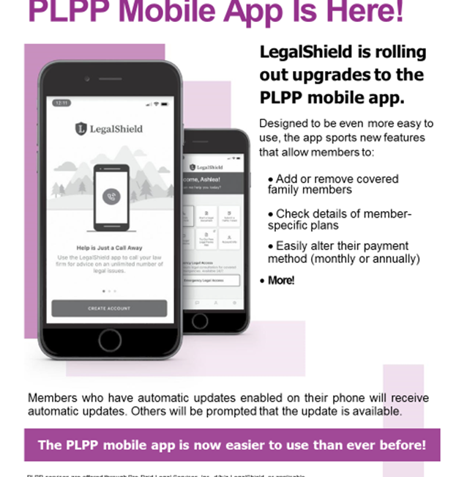
PLPP In The App Store
PLPP has a mobile app in the App store: LegalShield, Law Firms On Call.
While purchasing the PLPP membership, the client will have created a unique username and password. They will use this same username and password to log into the app.
Upon downloading the app and logging in, clients will now be in the Primerica Legal Protection Program Member App.
Members may also use their desktop to enter the LegalShield portal at mylegalshield.com.

Slide 20
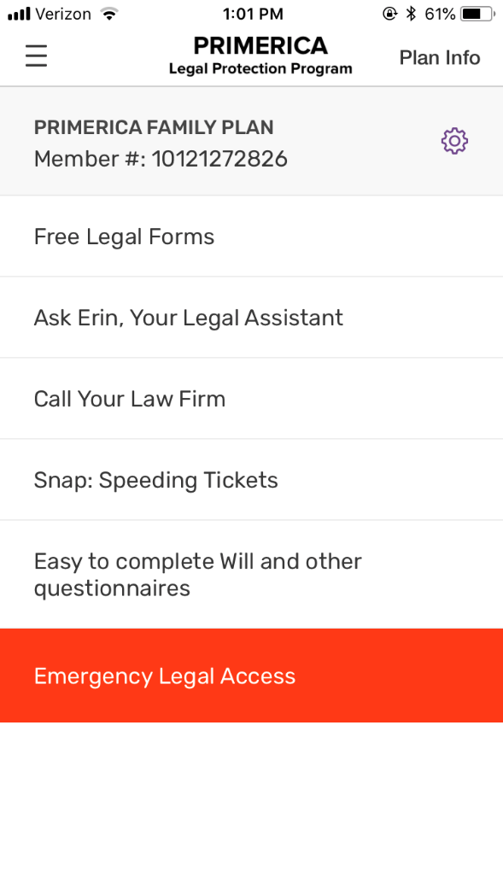
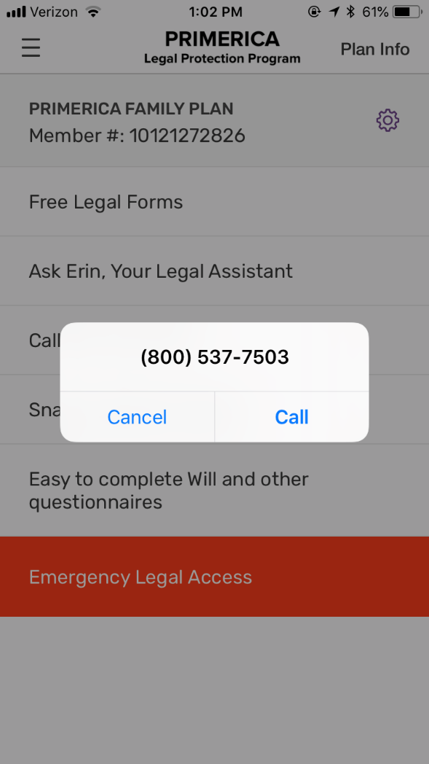
Mobile App Demo
PLPP Home Screen
PLPP Call Screen
Calling your Law Firm
Mobile App Demo is intended for illustration purposes only. Actual plan may differ based on type and state of plan. Not all plans and benefits are available in all states. See plan contract for complete terms, coverage, amounts, conditions and exclusions.

Slide 21
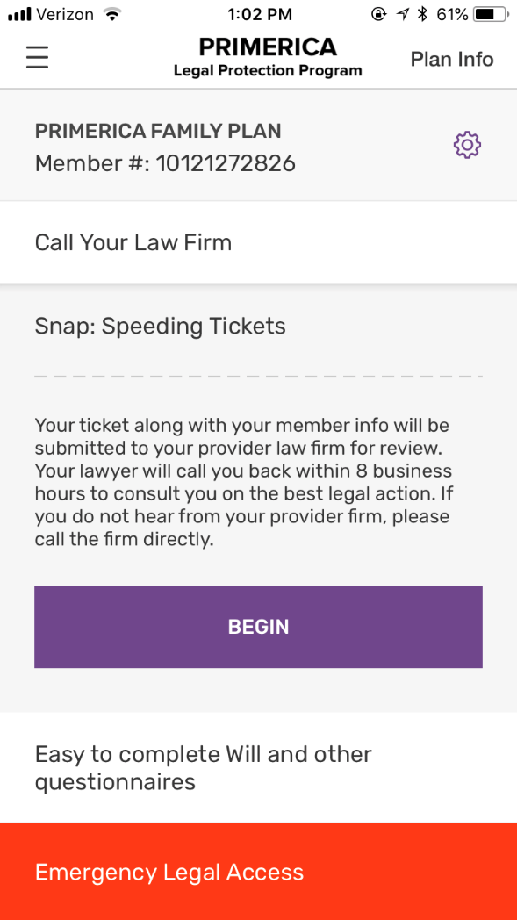
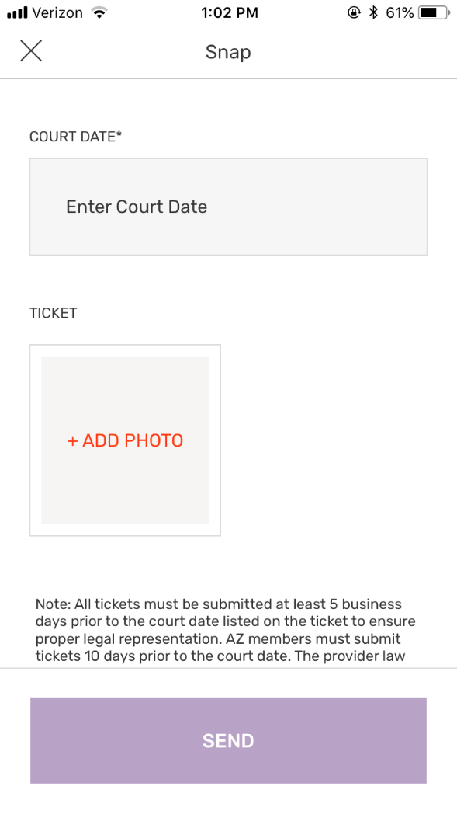
Mobile App Demo
Enter Court Date
Submit Speeding Ticket
Tap + Add Photo (Use existing photo or take a photo)
Mobile App Demo is intended for illustration purposes only. Actual plan may differ based on type and state of plan. Not all plans and benefits are available in all states. See plan contract for complete terms, coverage, amounts, conditions and exclusions.

Slide 22
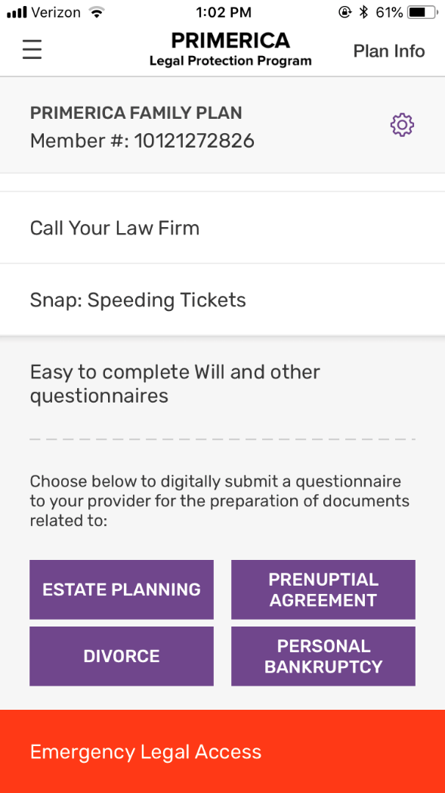
Mobile App Demo
Will questionnaire screen
Mobile App Demo is intended for illustration purposes only. Actual plan may differ based on type and state of plan. Not all plans and benefits are available in all states. See plan contract for complete terms, coverage, amounts, conditions and exclusions.

Slide 23
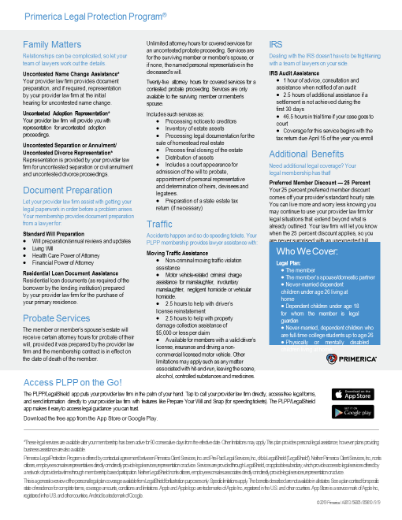
New Client Brochure

Slide 24
Primerica Legal Protection Program is a legal services program offered through contractual agreement between Primerica Client Services, Inc. and Pre-Paid Legal Services, Inc. d/b/a LegalShield. Neither Primerica Client Services, Inc., nor its officers, employees or sales representatives directly or indirectly provide legal services, representation or advice. Services are provided through LegalShield or its applicable subsidiary, which provide access to legal services offered by a network of provider law firms through membership-based participation. Neither LegalShield nor its officers, employees or sales associates directly or indirectly provide legal services, representation or advice.
The information contained in this material is for illustrative purposes only and is not a contract. Services and benefit availability may vary by state. See POL for a complete list of eligible states where plans are available, as well as specific licensing requirements in your state.
For training and education purposes only.

